Slide 1




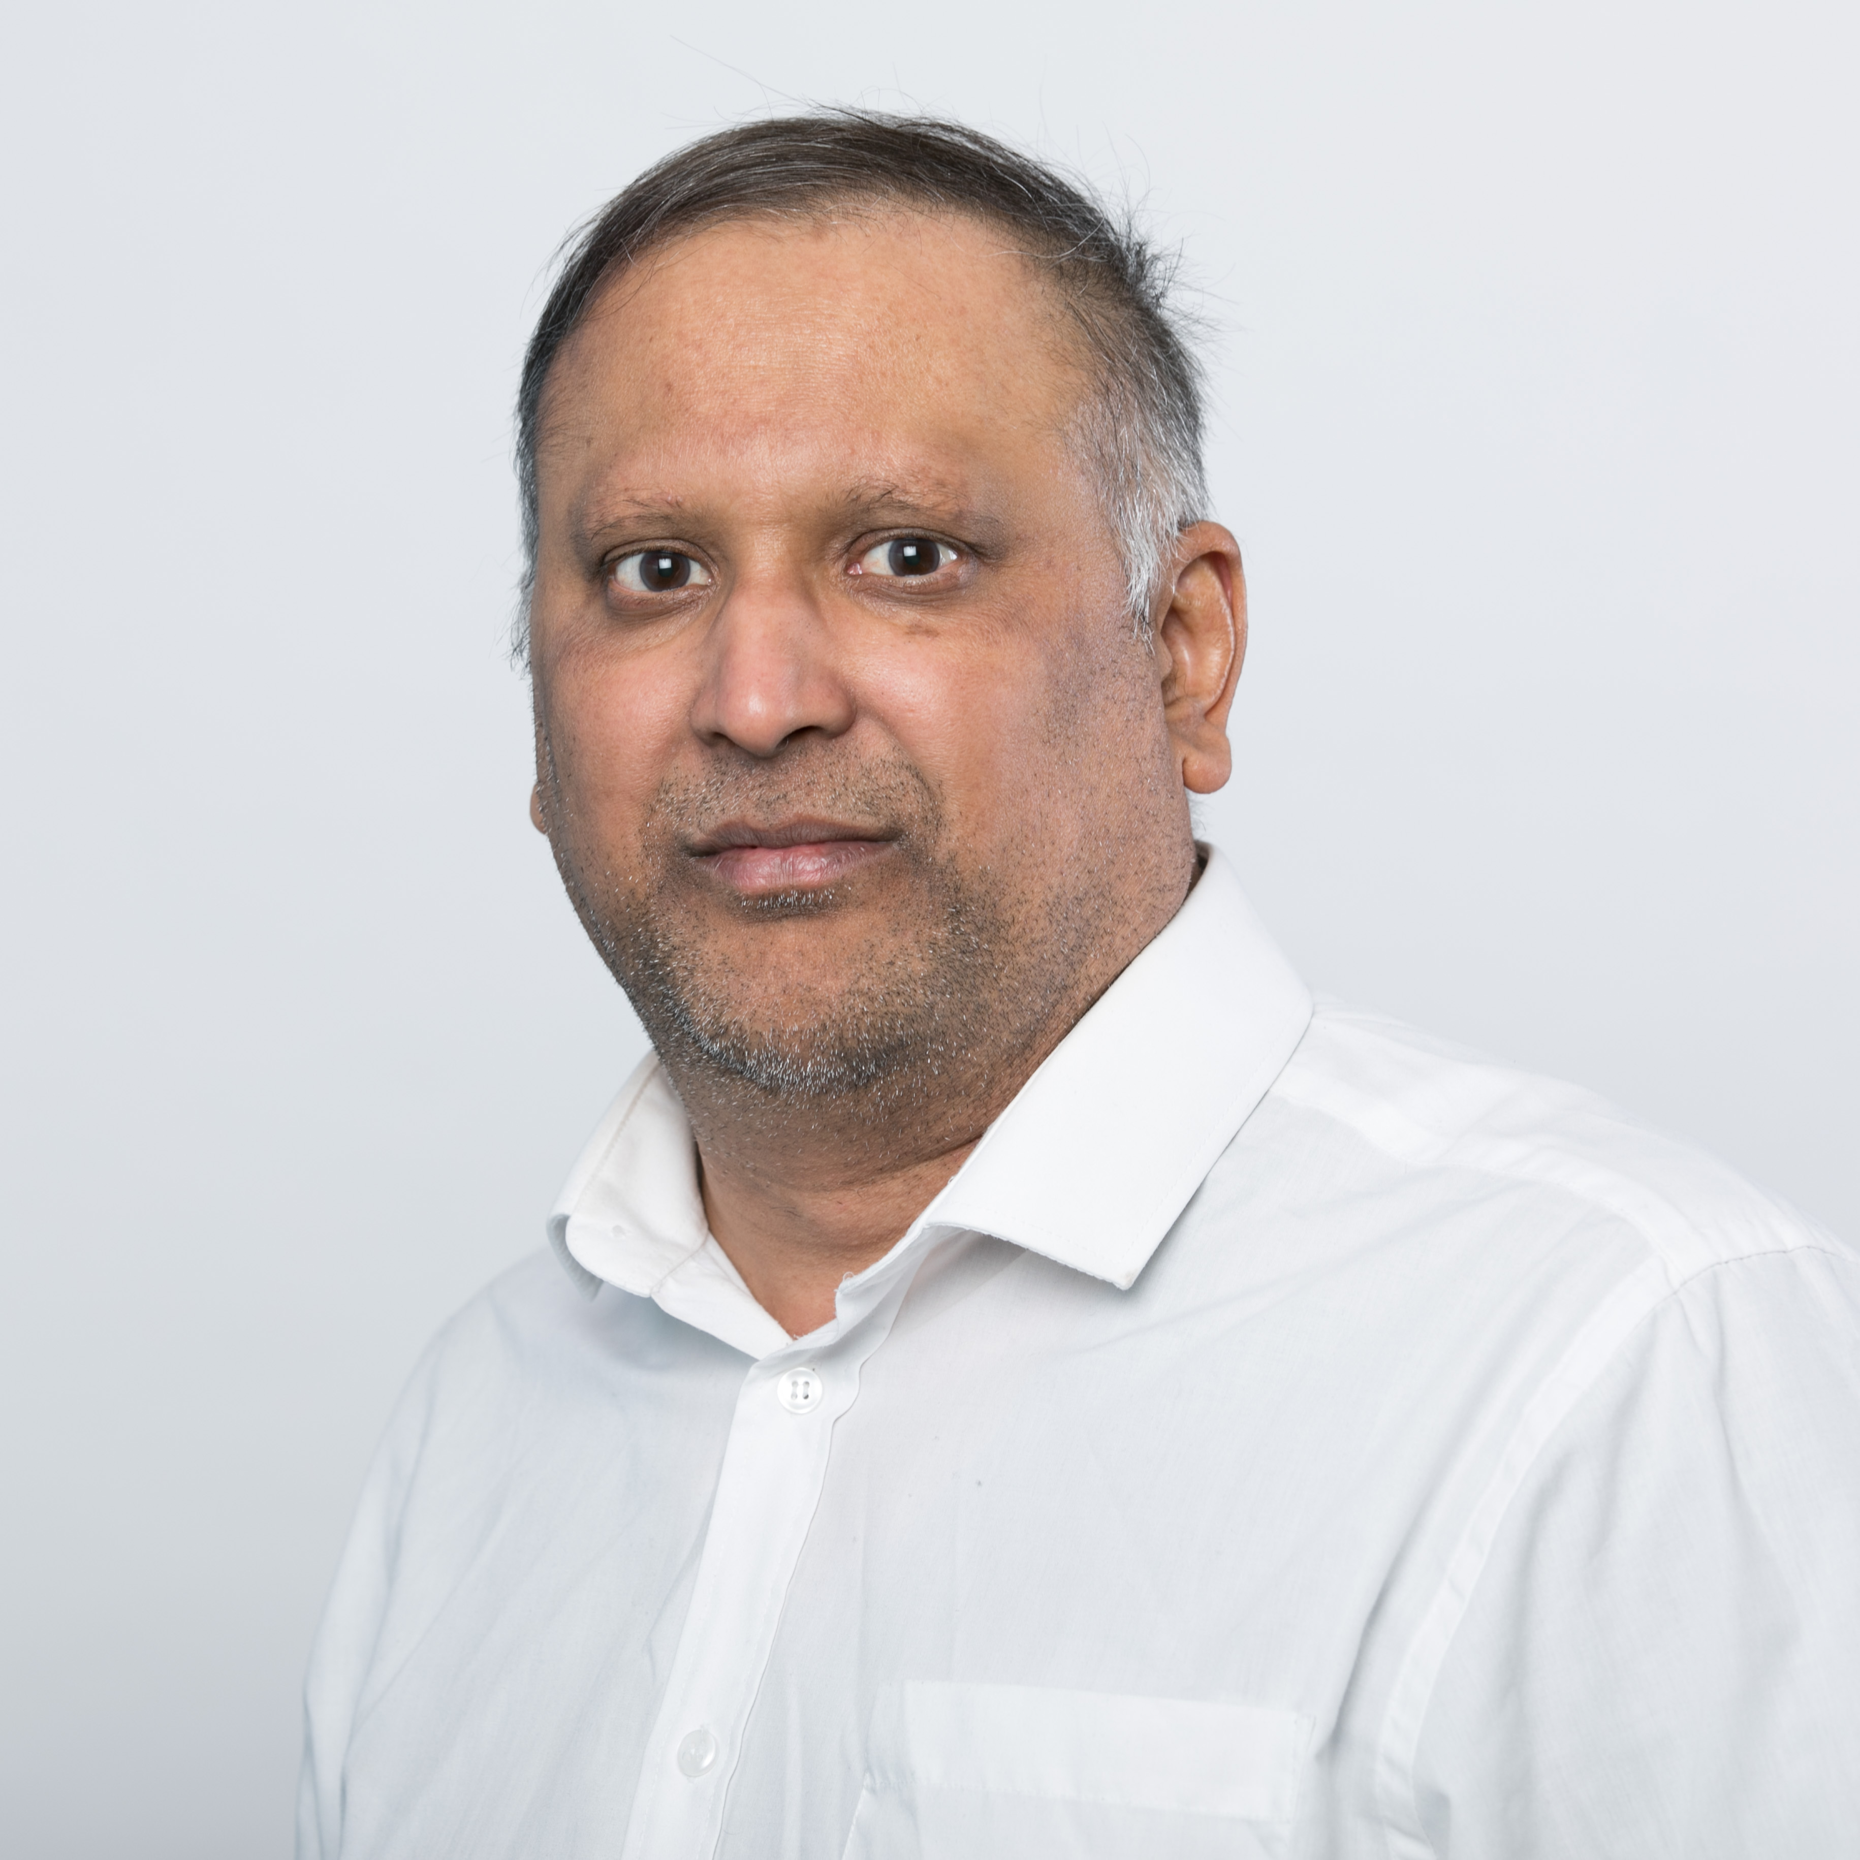
Karthik Sankaran | Senior Manager Solutions
Background
Relevant Experience
Hands on, complex design, automation and deployments such as the following one:
London Markets Trading Platform Provider Azure Infrastructure DevOps Engineer in the Digital Market Platform Support. He was also involved in the build, integration with Entra ID and support of the Azure Virtual Desktop environments, to be used by client’s reporting teams. Authoring and managing MFA and CA policies.
Global aerospace and defence company As an Azure Workstream Lead and Architect, he designed and implemented an enterprise-level landing zone based on the Open Cloud Framework, utilising Terraform and Azure DevOps pipelines for Infrastructure-as-Code deployment. Furthermore, Karthik was the lead Azure Infrastructure DevOps Engineer, leading the design and global implementation of a hybrid cloud solution across multiple business units, again leveraging Terraform and Azure DevOps for efficient infrastructure management. He was involved in the build, deployment and daily management of the Azure Virtual Desktop (AVD). It also involved usage reporting of the virtual desktops using Azure Monitor workbooks and recommend cost management of running personal / pooled session hosts.
Karthik is an Azure SME within Deloitte’s Cloud Managed Services with experience working in the financial services industry helping clients to achieve success in their transformational journey to Cloud.
Proven track record of solving complex business and system problems inherent in large-scale change programmes
deep technology skills in multiple Microsoft technologies and experience in infrastructure architecture and design for cloud migration.
Technical Expertise
Industry Expertise
Azure DevOps and Automations
Azure Infra. and Networking
Cloud Security and compliance
Windows Server Infrastructure Solutions​
Technology Architecture
  Insurance
  Banking
  Resourcing
© 2019 Deloitte MCS Limited. Private and confidential.
Notes:
To be updated

